Slide 1
MATLAB ASSIGNMENT
PREPARED BY GROUP 15

Slide 2
MEMBERS OF GROUP 15
NAME | REGISTRATION NUMBER | COURSE
Lugunga Timothy | BU/UG/2024/2679 | AMI
Bahemuka Godwins | BU/UG/2024/2583 | APE
Katusiime Joel | BU/UP/2024/1031 | WAR
Nabukwasi Shakira | BU/UP/2023/0862 | WAR
Naziwa Patricia | BU/UP/2024/0993 | PTI
Sidenya Kevin | BU/UP/2O24/3839 | WAR
Odong Eric Perry | BU/UP/2024/1059 | WAR
Nandijja Laila | BU/UP/2024/3833 | WAR
Namata Lilian Kizza | BU/UP/2024/0984 | MEB
Buluma Daniel | BU/UP/2024/4323 | AMI

Slide 3
INTRODUCTION TO MATLAB
MATLAB, which stands for matrix laboratory, is a high-performance programming language and environment designed primarily for technical computing
The first version of MATLAB was created in Fortran in the late 1970s as a simple interactive matrix calculator. This early iteration was built on top of two significant mathematical libraries: LINPACK and EISPACK, which were developed for numerical linear algebra and eigenvalue problems, respectively.
MATLAB was officially launched as a commercial product in 1984 by MathWorks, a company founded by Moler along with Jack Little and Steve Bangert. The software was reimplemented in C, with the addition of user-defined functions, toolboxes, and graphical interfaces.
Recent versions of MATLAB have introduced features like the Live Editor, which allows users to create interactive documents that combine code, output, and formatted text. This evolution reflects MATLAB's ongoing adaptation to meet the needs of its diverse user base across academia and industry.

Slide 4
NUMBER ONE
We were able to import, retrieve a dataset from Kaggle.com, importing it to MATLAB, converting tables in to structural arrays, outputting variables in to a single workbook with each year on separate sheets having clear column headings and sheet names.
Open Kaggle.com website from Google chrome.
Sign in to Kaggle.com and download any desired excel dataset and zip it in to a desired folder, whereby we obtained “coffee sales” dataset
Copy the file path into MATLAB.
In home tab, click on new script to open the editor.
Save the script as “GROUP 15”. And save it in the directory that is in your MATLAB path or current working directory.

Slide 5
PROCEDURE FOR NUMBER ONE
Load Dataset
filePath = 'C:\Users\LUGUNGA TIMOTHY\Desktop\semester 1\coffee sales.xlsx';
grouph = readtable(filePath);
Ensure a year column exists
if ~ismember('Year', grouph.Properties.VariableNames)
if ismember('Date', grouph.Properties.VariableNames)
grouph.Date = datetime(grouph.Date);
grouph.Year = year(grouph.Date);
else
error('Dataset must contain a Year or Date column.');
end
end

Slide 6
CONT.
split dataset into tables
years = unique(grouph.Year);
years = sort(years);
yearlyTables = struct();
yearlyStructArrays = struct();
for i = 1:length(years)
yr = years(i);
tbl = grouph(grouph.Year == yr, :);
yearlyTables.(sprintf('Y%d', yr)) = tbl;
yearlyTables.(sprintf('Y%d', yr)) = table2struct(tbl);
end

Slide 7
CONT.
Output each year into a single Excel workbook
outputFile = 'yearly_data_output.xlsx';
for i = 1:length(years)
yr = years(i);
tbl = yearlyTables.(sprintf('Y%d', yr));
writetable(tbl, outputFile, 'Sheet', num2str(yr));
end
disp(['✅ Data successfully exported to ', outputFile]);

Slide 8
CONT.
Getting the numeric columns in group15 dataset
numericCols = varfun(@isnumeric, tbl, 'OutputFormat', 'uniform');
numVars = tbl.Properties.VariableNames(numericCols);
% --- Line plot of first numeric variable ---
if ~isempty(numVars)
figure;
plot(tbl.(numVars{1}), 'k-s',LineWidth=0.5);
title(['Year ' num2str(yr) ' - Trend of ' numVars{1}]);
xlabel('Record number');
ylabel(numVars{1});
grid on;
saveas(gcf, ['line_' num2str(yr) '.png']);
close;
end

Slide 9
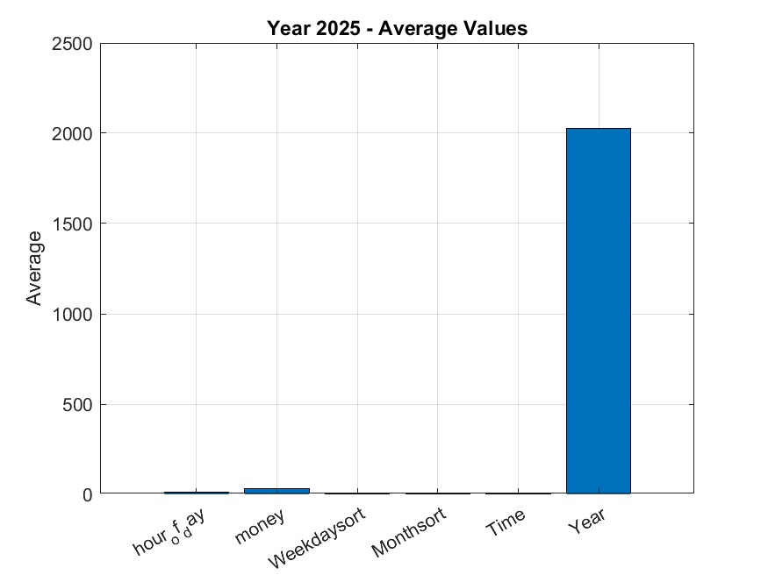
BAR CHART
Bar chart of averages
if ~isempty(numVars)
figure;
bar(mean(tbl{:, numericCols}, 'omitnan'));
set(gca,'XTickLabel', numVars);
title(['Year ' num2str(yr) ' – Average
Values']);
ylabel('Average');
grid on;
saveas(gcf, ['bar_' num2str(yr) '.png']);
close;

Slide 10
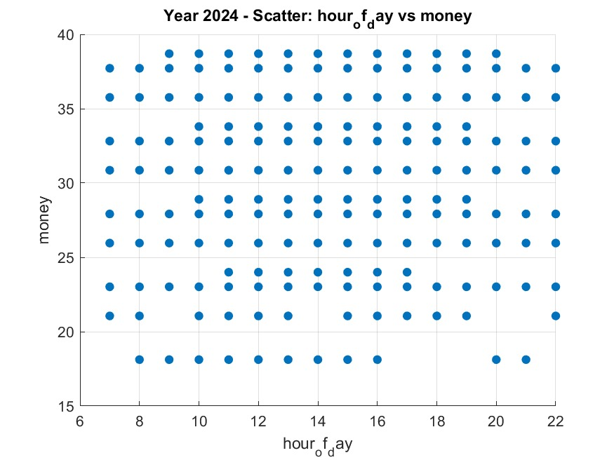
SCATTER PLOT
Scatter plot between first two numeric variables
if numel(numVars) >= 2
figure;
scatter(tbl.(numVars{1}), tbl.(numVars{2}), 'filled');
title(['Year ' num2str(yr) ' - Scatter: ' numVars{1} ' vs ' numVars{2}]);
xlabel(numVars{1});
ylabel(numVars{2});
grid on;
saveas(gcf, ['scatter_' num2str(yr) '.png']);
close;

Slide 11
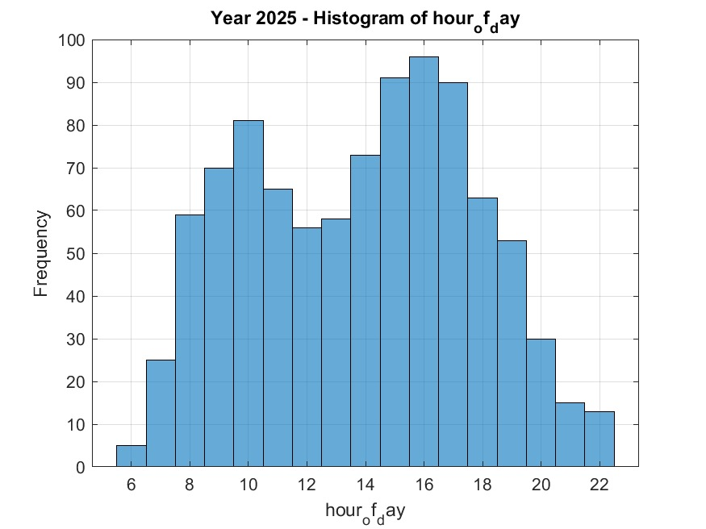
HISTOGRAM
Histogram of first numeric variable
if ~isempty(numVars)
figure;
histogram(tbl.(numVars{1}));
title(['Year ' num2str(yr) ' - Histogram of ' numVars{1}]);
xlabel(numVars{1});
ylabel('Frequency');
grid on;
saveas(gcf, ['hist_' num2str(yr) '.png']);
close;
end
end
disp('✅ Plots created and saved as images');

Slide 12
NUMBER TWO
Procedure
Launch MATLAB
Open a new script to open editor
Obtain each member’s personal information
Generate a MATLAB code that can store each member’s attributes i.e. Name, Course, Age, District, Interests, Background, Facial representation.
Run the achieved code in MATLAB.

Slide 13
MEMBER ONE AND TWO
Define the struct
members = struct('Name',{},'Age',{},'Homedistrict',{},'Course',{},'Tribe',{},'Village',{},'Interest',{}, 'FacialRecognition',{});
disp('Step 1: Empty structure "groupMembers" created.');
Member 1
groupMembers(1).name = ' Lugunga Timothy';
groupMembers(1).age = 21;
groupMembers(1).homeDistrict = 'Eastern District';
groupMembers(1).village = 'Namutumba';
groupMembers(1).religion = 'Christianity';
groupMembers(1).course = 'AMI';
groupMembers(1).tribe = 'musoga';
groupMembers(1).interests = {'Programming , football'};
groupMembers(1).facialRepresentation = 'Has no beard';
Member 2
groupMembers(2).name = 'NAMATA LILLIAN KIZZA';
groupMembers(2).age = 23;
groupMembers(2).homeDistrict = 'central District';
groupMembers(2).village = 'Pinecrest';
groupMembers(2).religion = 'Christianity';
groupMembers(2).course = 'MEB';
groupMembers(2).tribe = 'muntoro';
groupMembers(2).interests = { 'Robotics'};
groupMembers(2).facialRepresentation = 'Wears glasses';
The above format is then repeated for members(3 to 10) along with their corresponding personal attributes.

Slide 14
CONT.
Save members into a .mat file for later use
fileName = 'groupData.mat';
save(fileName, 'groupMembers');
disp([' The variable "groupMembers" has been successfully saved to the file "' fileName '".']);
disp('You can load it back anytime using the command: load("groupData.mat")');
% Creating a Detailed and Expanded Database for Statistical Analysis
clc;
clear;

Slide 15
CONT.
Define possible attributes for random generation
names = ["Lugunga Timothy", "NAMATA LILLIAN KIZZA","NANDIJJA LAILA", "KATUSIIME JOEL", "BULUMA DANIEL", "ODONG ERICK PERRY", "BAHEMUKA GODWINS", "NAZIWA PATRICIA", "SIDENYA KEVIN", "NABUKWASI SHAKIRA"];
districts = ["Central District", "Northern District", "Western District", "Southern District", "Eastern District"];
religions = ["Christianity", "Buddhism", "Islam", "None", "Judaism","PENTACOSTAL"];
courses = ["AMI","MEB","PTI","WAR","APE"];
tribes = ["Musoga", "mutoro", "mugisu","langi","acholi","munyankole", "mukiga"];
Creating the structure
groupMembers = struct('name', {}, 'age', {}, 'homeDistrict', {}, 'religion', {}, 'course', {}, 'tribe', {});
Generating 10 members with random data
numMembers = 10;
for i = 1:numMembers
groupMembers(i).name = names(randi(length(names)));
groupMembers(i).age = randi([18, 32]);
groupMembers(i).homeDistrict = districts(randi(length(districts)));
groupMembers(i).religion = religions(randi(length(religions)));
groupMembers(i).course = courses(randi(length(courses)));
groupMembers(i).tribe = tribes(randi(length(tribes)));
end
% saving the detailed dataset
save('groupData.mat', 'groupMembers');
disp(['A detailed database with ', num2str(numMembers), ' members has been
created and saved as "groupData.mat".']);
disp('Ready for statistical analysis.');
% Analyze and Visualize Statistical Characteristics
clc;
clear;
close all;

Slide 16
CONT.
Data Loading and Preparation
disp('Loading and Preparing Data ');
if exist('groupData.mat', 'file')
load('groupData.mat');
disp(['Successfully loaded data for ‘
, num2str(length(groupMembers)), ' members.']);
else
error('"groupData.mat" not found. Please run
"create_detailed_database.m" first.');
end
ages = [groupMembers.age];
districts = categorical([groupMembers.homeDistrict]);
religions = categorical([groupMembers.religion]);
courses = categorical([groupMembers.course]);
tribes = categorical([groupMembers.tribe]);
disp('Data has been extracted into individual variables.');
% Analysing Categorical Data
disp(' Analysis of Categorical Data ‘);
Analysis 1: Home Districts
disp('Home District Distribution ');
[district_counts, district_names] = histcounts(districts);
district_table = table(district_names', district_counts’,
'VariableNames', {'District', 'Count'});
disp(district_table);

Slide 17
CONT.
Analysis 2: Course Enrollment
disp(' Course Enrollment Distribution ');
[course_counts, course_names] = histcounts(courses);
course_table = table(course_names', course_counts', 'VariableNames’,
{'Course', 'Count'});
disp(course_table);
% Analysis 3: Tribe Membership
disp('Tribe Membership Distribution ');
[tribe_counts, tribe_names] = histcounts(tribes);
tribe_table = table(tribe_names', tribe_counts', 'VariableNames', {'Tribe', 'Count'});
disp(tribe_table);
disp(' ');
Visualize Categorical Data (CORRECTED SECTION)
disp(' Generating bar and pie charts for categorical data.');
% Bar Chart for Course Enrollment
figure('Name', 'Categorical Data Analysis');
subplot(2, 1, 1);
bar(course_names, course_counts);
title('Number of Members per Academic Course');
xlabel('Course');
ylabel('Number of Members');
grid on;

Slide 18
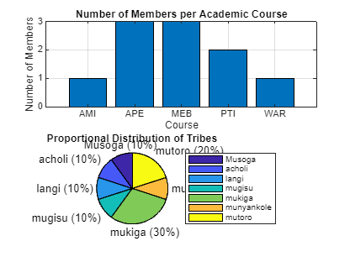
PIE CHART
Pie Chart for Tribe Distribution
subplot(2, 1, 2);
pie(tribes);
title('Proportional Distribution of Tribes');
legend(tribe_names, 'Location', 'eastoutside');

Slide 19
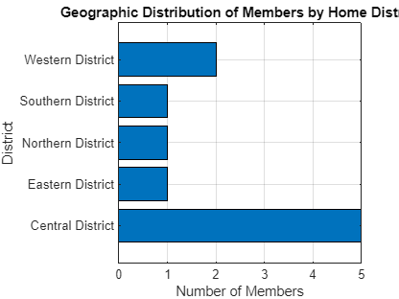
FIGURE
A separate figure for District distribution
figure('Name', 'Geographic Analysis');
barh(district_names, district_counts);
title('Geographic Distribution of Members by Home District');
xlabel('Number of Members');
ylabel('District');
grid on;
disp('All analyses and visualizations are complete.');

Slide 20
CONCLUSION
Exposure to Kaggle.com proves to be fruitful as it holds a variety of datasets serving as a source of info to group students. The assignment has furthermore enabled students to convert tables in to structural arrays, output variables into a single workbook and write code that stores multiple info into a single variable.

